Slide 2
Current Facts on the Ethnic violence in Manipur
The violent ethnic conflict that began on the 3rd May 2023 evening, and it still continues between the majority Meitei (predominantly Hindus) and minority tribals (Kuki, Hmar, Zou, Paite – all Christians) in Imphal, Manipur has left more than:
170 deaths (few still missing and unaccounted for).
1800 + houses burnt.
310 + churches burnt down.
500 + injured people and hospitalized.
Over 50,000+ Internally Displaced People (IDP).

Slide 3
Current Facts on the Ethnic violence in Manipur
This ethnic violence has left thousands of tribal Christians to flee Imphal valley:
Kangpokpi (45+ Relief Camps)
Churachandpur (Lamka) (40+ Relief Camps).
Hundreds are taking shelter in other tribal hill districts and other parts of India:
1. Manipur
2. Nagaland (Kohima & Dimapur)
3. Assam (mostly in Guwahati),
4. Meghalaya (mainly in Shillong)
5. Delhi, Bangalore, Mizoram, Chennai, Kolkata.

Slide 4
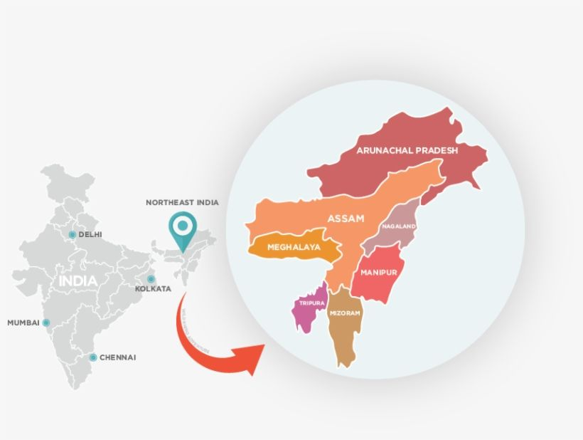
SAVE MANIPUR DAY of PRAYER
1. Pray for restoration of peace in Manipur.
2. Pray for the State & Central government to call for peaceful dialogue and find a permanent solution immediately.
3. Pray for the Internally Displaced Person (IDP) for their rehabilitation and healing (physical, emotional & spiritual).
4. Pray that this genocide against the tribal Christians in Manipur will stop.
5. Pray for the Christians in Manipur whose churches have been completely burnt down and destroyed.

Slide 5
SAVE MANIPUR DAY of PRAYER
6. Pray for those who have lost their family, relatives, friends, and for those who have lost all their properties in Imphal (houses, cars, household items, clothes, children’s education books, educational certificates, land/property documents – are either burned or destroyed. houses, vehicles, etc).
7. Pray for strength for the Meitei Christians during this challenging time to their faith.
8. Pray for spiritual awakening amidst this crisis and strength to overcome the terrible trauma for the families (parents and children).
9. Pray for Christian leaders who escaped this violent conflict - to be strong in the Lord as they lead their people during this crisis.
10. Pray for the Manipur Churches - to provide comfort, relief, forgiveness, reconciliation ministry.

Slide 6
Evangelical Baptist Convention (EBC)
1. Pray for the return of normalcy and peace in Manipur.
2. Pray that the destruction of more than three hundred churches in Imphal valley will not dampen the faith of Christians rather they will grow stronger wherever they are resettled.
3. Pray for healing and strength to forgive the enemy where more than one hundred innocent tribal Christians have been killed.
4. Pray for the many people who are in the relief centres whose future have become uncertain. While some of the displaced peoples can leave the relief centres to start a new life, there are still many who cannot leave the centres as they lost everything including land and houses.
5. Pray that the Evangelical Baptist Convention whose core value is to bring the gospel to others and plant self-reliant churches will send out missionaries to the rest of the world. Four missionaries have been commissioned to go, including one couple to overseas.

Slide 7
PRAY for Member Bodies in the APBF!

Slide 8
Nepal Baptist Church Council (NBCC)
1. NBCC plans to "Baptist House Building concept" pray for all the management and financial needs.
2. Pray for skillful manpower in the NBCC and local churches.
3. NBCC plans to send missionaries in the diaspora mission field with the partnership of local Baptist Churches and Baptist families.
4. Pray for the program of 2023 to fulfill in time.
5. Pray for the good governance of Nepal government and stable government.
6. Pray for many souls to win for Christ in this generation.

Slide 9
Tripura Baptist Christian Union (TBCU)
1. A Member of Legislative Assembly in Tripura have spoken to the media and public meeting that those are converted into Christianity will be removed from the Scheduled Tribe status. They will not get any benefit from the Government. Pray for God's intervention.
2. Indirect persecution is happening in the state of Tripura. Pray for strengthening of believers in their faith.
3.Pray for unity in the church among the believers.
4. Pray church leaders, church congregations need to work hard for increase of believers in the state.

